Slide 1
Sample composition
All population
Variable | Mean | Std. Dev. | Min | Max | N
Gender (female) | 0.541 | 0.559 | 0 | 1 | 283
Age | 26.799 | 7.463 | 19 | 65 | 283
Household size | 3.261 | 1.144 | 1 | 7 | 283
Number of children | 0.163 | 0.455 | 0 | 3 | 283
Madrid
Variable | Mean | Std. Dev. | Min | Max | N
Gender (female) | 0.550 | 0.493 | 0 | 1 | 181
Age | 26.116 | 6.648 | 19 | 58 | 181
Household size | 3.249 | 1.132 | 1 | 7 | 181
Number of children | 0.133 | 0.413 | 0 | 3 | 181

Slide 2
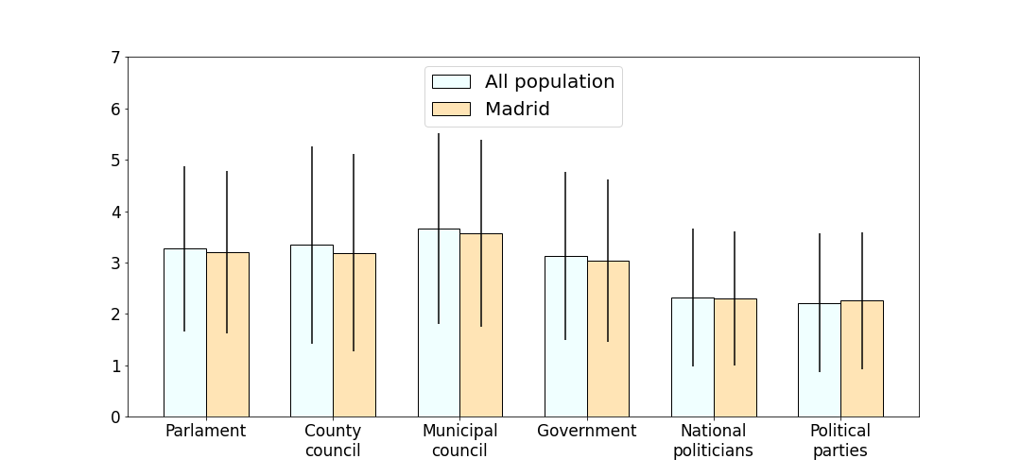
How much do you personally trust the following institutions from 1 to 7, where 1 means ‘No trust at all’ and 7 means ‘Trust compltely’?

Slide 3
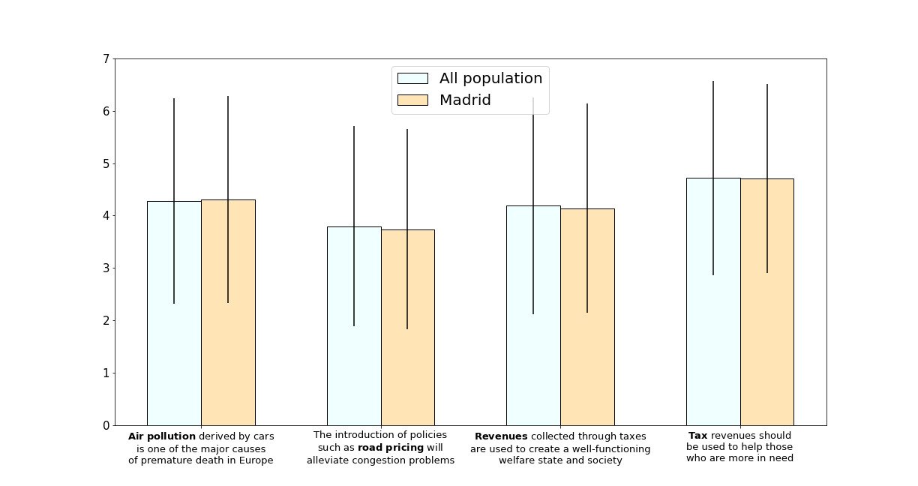
How much do you agree with the following statements from 1 to 7, where 1 means ‘I completely disagree’ and 7 means ‘I completely agree’?

Slide 4
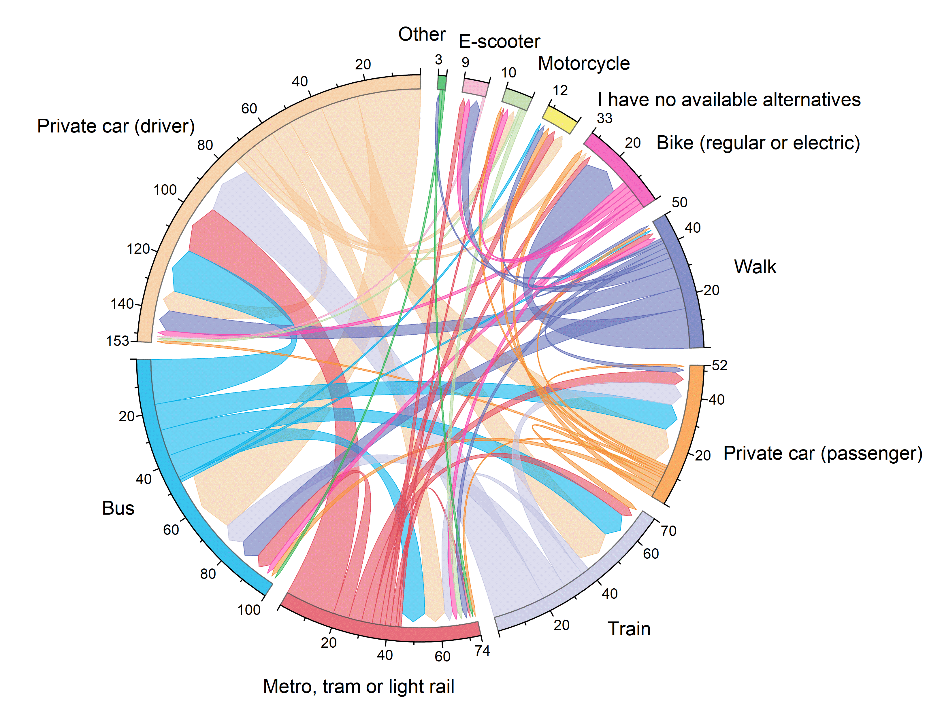
The chord diagram represents the flow between different transport means. The arrows display the transition between the first alternative (the preferred transport mean) and the second alternative.
All population

Slide 5
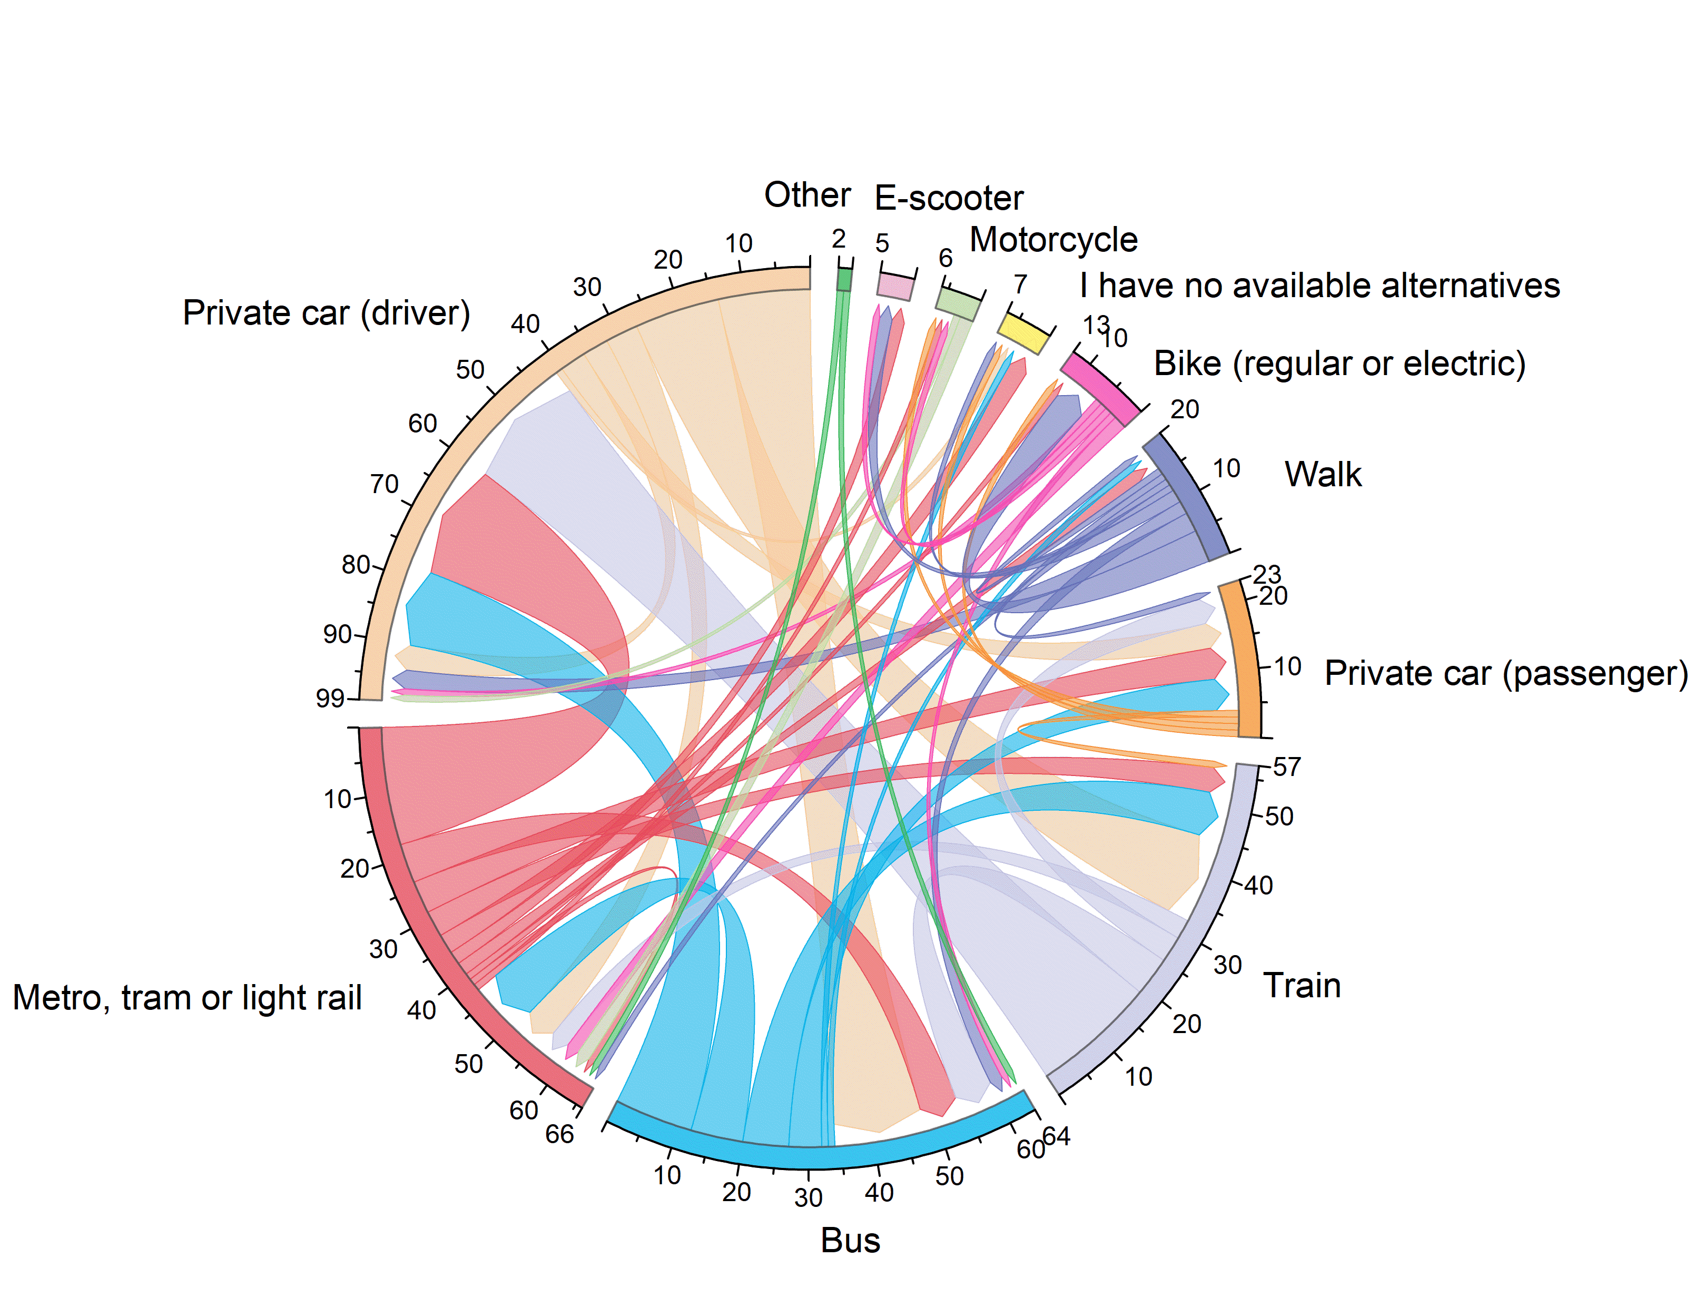
Madrid

